Slide 1
CTS 6319 Cyber Security: Measurement and Data Analysis
Dr. Elias Bou-Harb
ebouharb@fau.edu EE 503B
Office hours: Mondays 3-4pm

Slide 2
Material
On Canvas
Research Papers 7:
Bro: a system for detecting network intruders in real-time

Slide 3
Intrusion Detection Systems
A hardware or software solution that flags “behavior” as anomalous
Probably the most researched topic across all security domains
The definition of a solution and behavior can take a plethora of styles/types

Slide 4
Applications of IDS
Corporate networks
Cyber Sec Response Teams (Ex: CERT)
Critical infrastructure (Ex: Smart Grid)
Others?

Slide 5
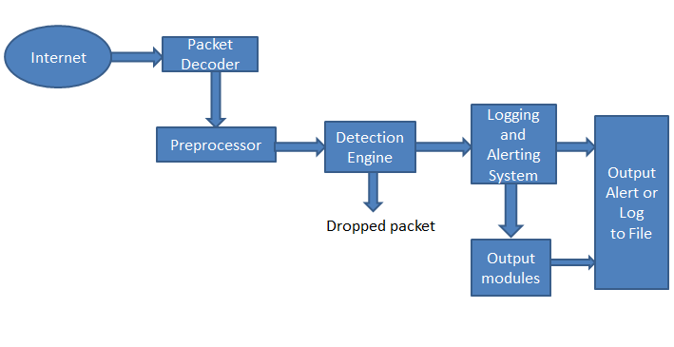
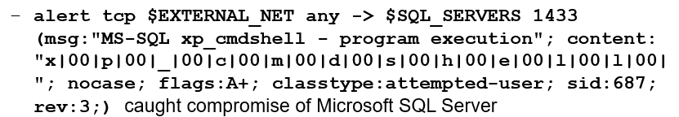
Intrusion Detection Systems-Snort

Slide 6
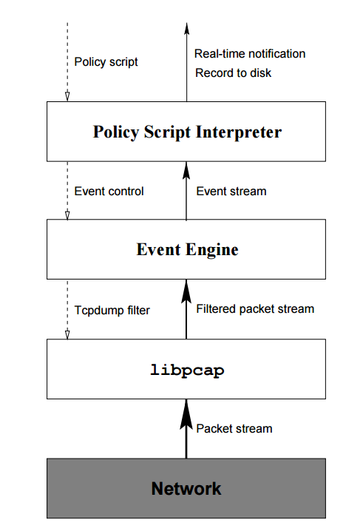
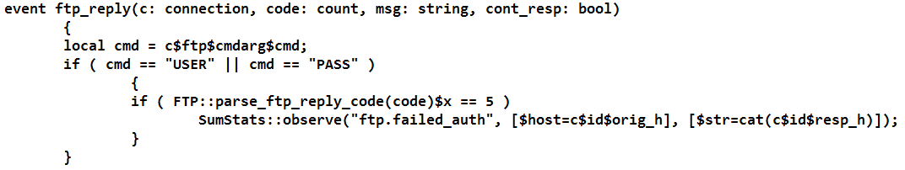
Intrusion Detection Systems-Bro

Slide 7
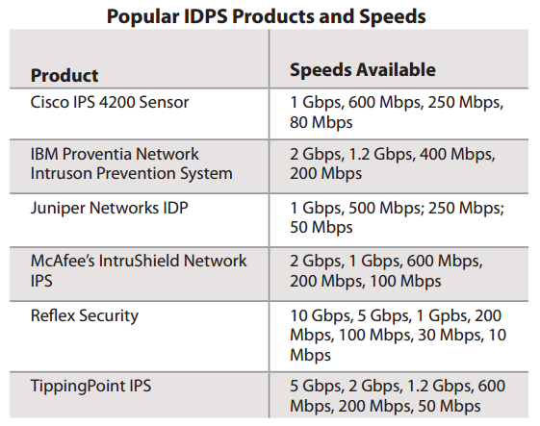
Intrusion Detection Systems-Commercial

Slide 8
Types of IDS
Active vs Passive
Active refers to an IPS: Intrusion Prevention System
Passive refers to an IDS: detection

Slide 9
Types of IDS
Host based vs network based
Host IDS
Per machine deployment
Monitor DLLs, OS, network, and memory.
Pros? Cons?
Network IDS
In some network deployment setting
Concepts of ingress and egress filtering
Promiscuous mode operations
Pros? Cons?

Slide 10
Network IDS deployments
Edge, DMZ, Back-to-Back. Pros? Cons?

Slide 11
Types of Network IDS
Rule (Signature-based) Vs Anomaly Detection
Signatures:
Good for known attacks
Typically, generate an acceptable level of false positive
Can not infer unknown attacks
Anomaly:
Can possible detect unknown attacks
Generate a lot of false positives
Techniques: ML, Time series, Classification, etc.

Slide 12
Signatures
Descriptive statistics
Ex: Frequency of failed logins
Simple statistics
Ex: Hurst parameter
Descriptive rules
Ex: Snort Rule
Thresholds
State modeling

Slide 13
Anomaly Detectors
Stochastic modeling (non-time series)
Ex: MDPs
Rule modeling
Ex: Markov chains
Learning techniques
Ex: ANN
Time series
Ex: Fourier Transform, Kalman etc.

Slide 14
IDS Characteristics
Time of detection
Data granularity
Sources of Data
Processing Mode
Data storage Architecture
Resilience
Interoperability and scalability
Portability

Slide 15
Few example of intrusions
root compromise
Web server defacement
Cracking passwords
Copying databases containing credit card numbers
Viewing sensitive data without authorization
Running a packet sniffer
Distributing pirated software
Impersonating an executive to get information
Using an unattended workstation
Confidentiality
Integrity
Availability
Non-repudiation
Auditing

Slide 16

Honeypots
An IS that is specifically used to lure attackers
Can virtually mimic any service
Aims at inferring attackers strategies as well as “preventing” the exploitation of real systems. Protection by deception
Challenges include configuration, management, and protection

Slide 17
Honeypots: Desired Features
Legitimacy as network assets/resource
Difficulty to ``break-in’’
``Mingling’’ factor
Extensible and flexible

Slide 18
Honeypots: Few Advantages
Collect much needed real cyber security data sets
Build signatures that aim at reducing both, false positives and false negatives

Slide 19
Honeypots: Types
Low interaction
Mimics OS and other resources actions only
Reduces risks of real exploitation
Can not infer full attacker’s strategies

Slide 20
Honeypots: Types
High interaction
Implements full OSs and services
Increases interactivity level
Increases risk of exploitation

Slide 21

Rare Industrial Honeypot

Slide 22
OpenCanary Honeypot
https://www.youtube.com/watch?v=W7U2u-qLAB8

Slide 23
CTS 6319
Cyber Security: Measurement and Data Analysis
Dr. Elias Bou-Harb
ebouharb@fau.edu EE 503B
Office hours: Mondays 3-4pm
http://faculty.eng.fau.edu/ebouharb/

